Slide 1




Catalyzing Industry Growth
Transforming Business
Transforming India

Slide 2






FutureSkills Prime
A Govt. of India & nasscom initiative
is a joint initiative by MeitY & nasscom, aimed at making India a Digital Talent Nation.
FutureSkills Prime is an innovative and evolutionary ecosystem designed to equip learners with cutting-edge skills essential in today's rapidly evolving digital landscape. Our industry-backed nasscom certification programs are aligned with National Occupational Standards (NOS) and National Skills Qualification Framework (NSQF), enabling learners to acquire in-demand skills that are highly valued by employers.
Empowering learners at every step of their journey - from course selection to skill-building to finding employment.
Assess your Aptitude with Competency Diagnostics
Acquire Cutting Edge Skills with Foundational, & Deep Skilling Learning Content
Open the door to new career opportunities with PRIME Careers Fairs and Recruitment Drives
Get nasscom certified. Earn badges for better Job Opportunities
Fund your Learning Ambitions with Gol Incentives through Skills Wallet
Showcase skills through Skills Passport

Slide 3
Project Steps
At-a-glance
Step 1
Step 2
Step 3
Step 4
Step 5
Step 6
Signup on Future Skill Prime Portal
Complete GOI Registration
Get DigiLocker Verified
Enroll for Exploratory Data Course complete It and Take Assessment for Exploratory Data Course for free* worth INR 600
Complete The Internship With HCL
Apply for GOI incentive after final Completion of Internship when directed by the Faculties
* One free attempt

Slide 4
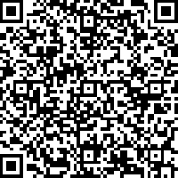
Project Steps
Step 1
At-a-glance
Step 4
Step 5
Signup on FutureSkills Prime Portal using your institutional E mail ID
https://tinywebs.site/TDrd66
Submit Google Form
Choose from 100’s courses as per our choice
Click On SignUP, Enter Your Full Name, Email ID and Choose Password
Update Your Profile by Going on My Dashboard
Use College area Pincode - 201009
Current Occupation – Career Aspirants
Highest education – Under Graduates
Education Status – Pursuing
College Name – Choose others then a separate bracket will open FILL- ABES Engineering College Ghaziabad

Slide 5
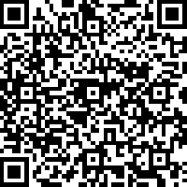
Project Steps
Step 2
At-a-glance
Step 4
Step 5
GOI Registration
https://tinywebs.site/TDrd66
Submit Google Form
Choose from 100’s courses as per our choice
Fill the Form with Your Basic Details and Upload, Passport sixe Photo, 10th Marksheet, and College ID

Slide 6
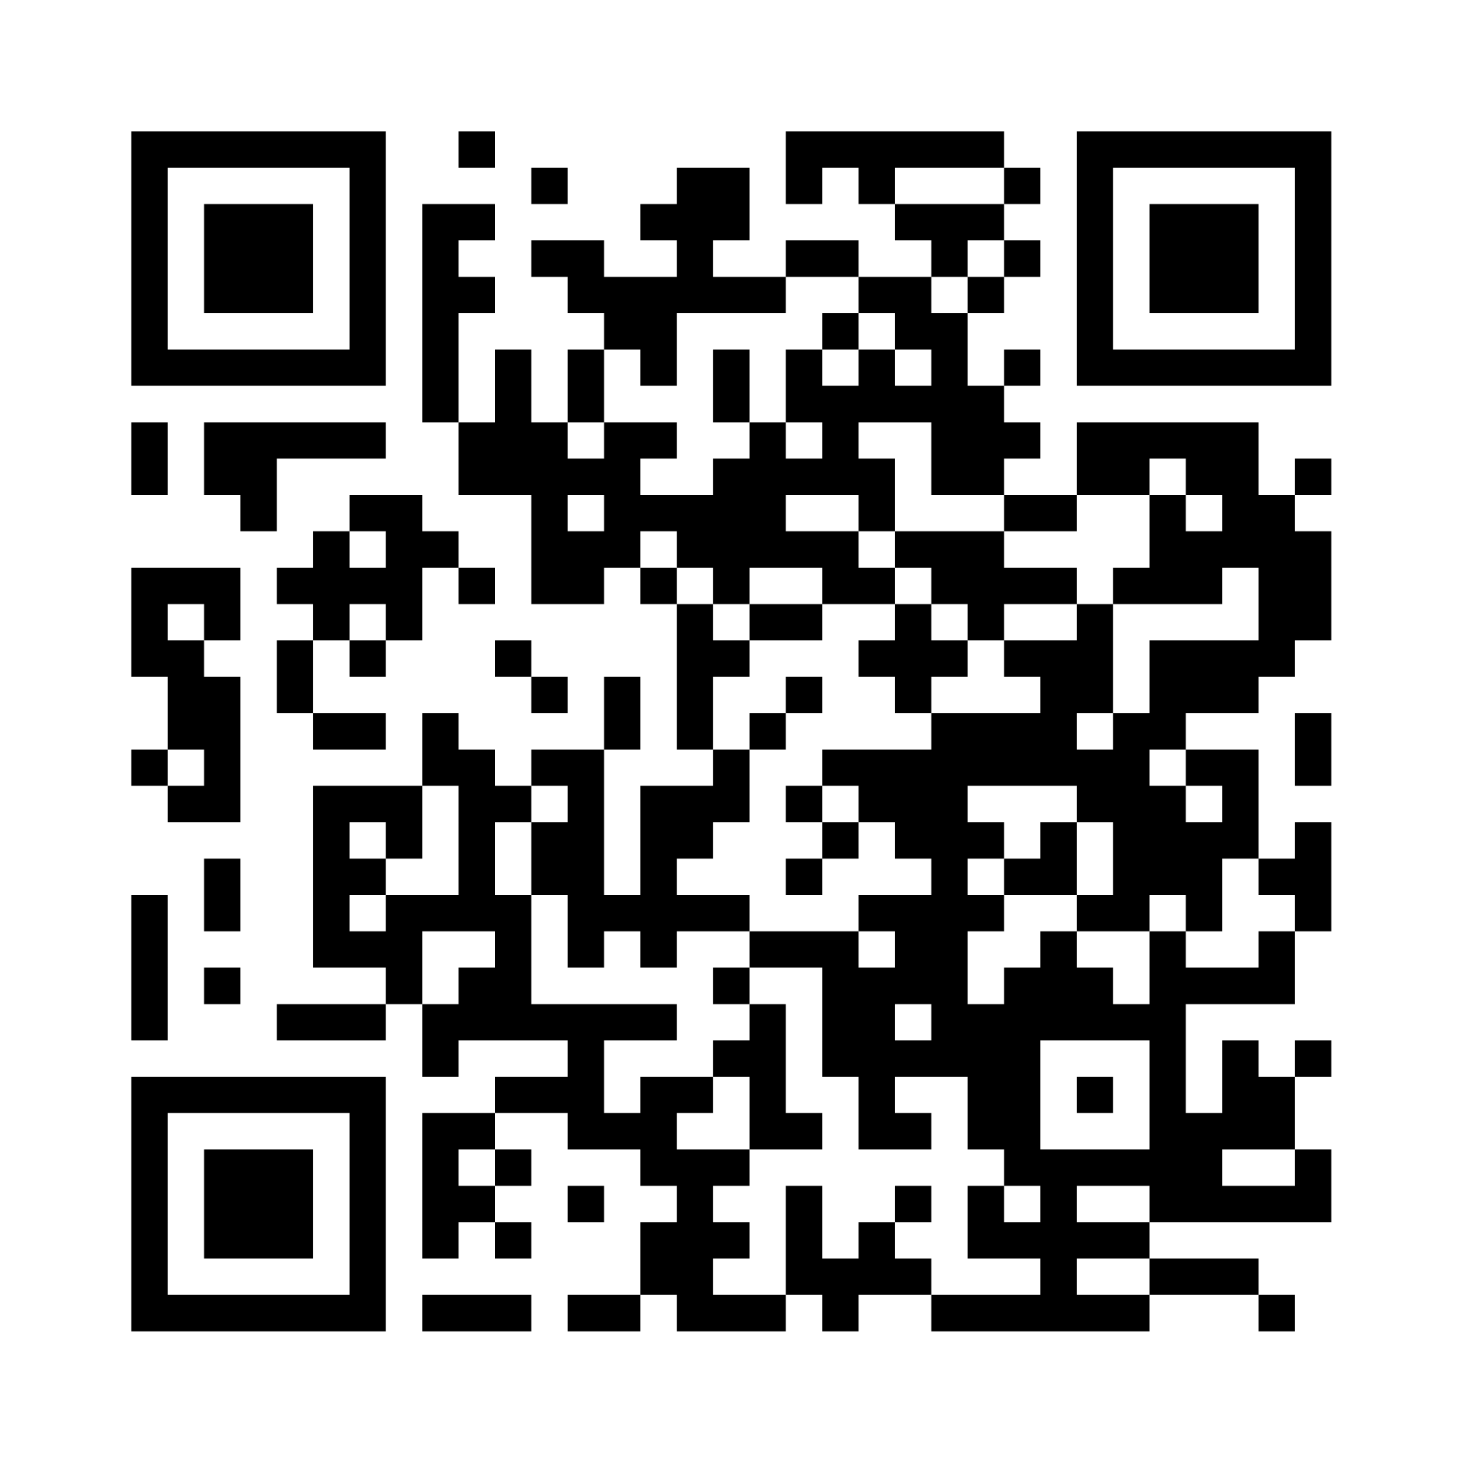
Project Steps
Step 1
Register on Future Skill Prime Portal
Step 3
At-a-glance
Get Digilocker verified
https://www.futureskillsprime.in/info/digilocker/
* One free attempt

Slide 7
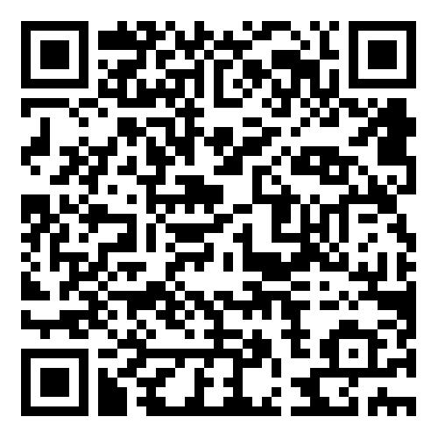



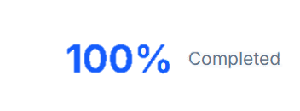
Project Steps
Step 1
Register on Future Skill Prime Portal
Step 4
At-a-glance
Complete Proposed Course https://www.futureskillsprime.in/course/exploratory-data-analysis/
Step 4
Step 5
Submit Google Form
Choose from 100’s courses as per our choice

Slide 8
Project Steps
Step 1
Register on Future Skill Prime Portal
Step 5
At-a-glance
Complete the Internship with HCL
* One free attempt

Slide 9
Project Steps
Step 1
Register on Future Skill Prime Portal
Step 6
At-a-glance
Apply For GOI Incentive
My Dashboard-> My Ledger-> Click Apply->
After Applying Students will receive the CDAC Login Credentials, Using that Credential Students have to Loging and Fill the Bank Account Details.
* One free attempt

Slide 10
THANK YOU
Step 1
Register on Future Skill Prime Portal
Stay Skilled. Stay Ahead

